Slide 1

DEEPAKKUMAR V
Course : Generative AI for Engineering (E2324)
Madras Institute of Technology Campus, Anna University
FoodGAN : Generating Realistic Images of Food
Using Generative adversarial networks
Final Project :

Slide 2
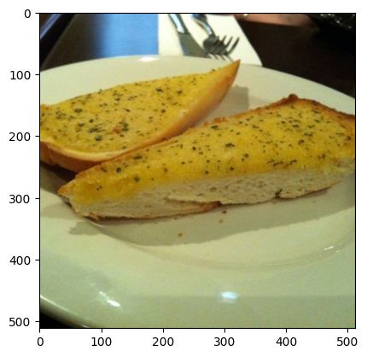
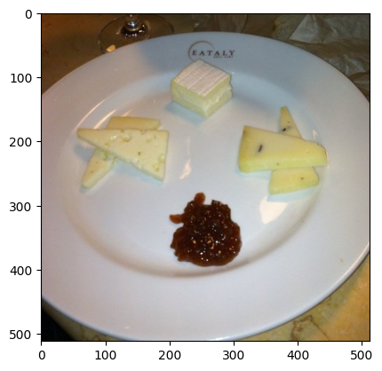
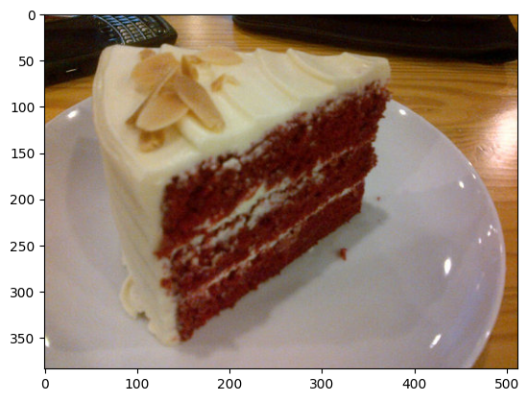
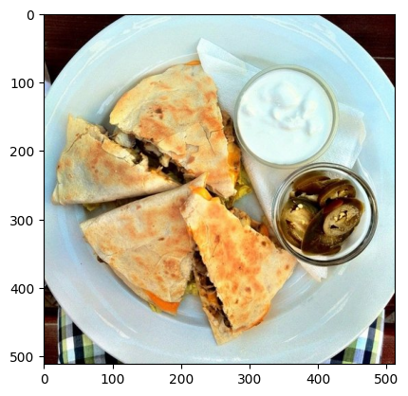
PROJECT TITLE
Food-GAN:
Generating Realistic Images of Food
Using Generative adversarial networks
DataSet Link : https://www.kaggle.com/datasets/trolukovich/food11-image-dataset

Slide 3



AGENDA
The agenda of the FOODGAN project is to utilize Generative Adversarial Networks (GANs) implemented with deep learning techniques and PyTorch to manipulate art images.
By employing GANs, the project aims to generate new data resembling the statistics of a given training set, particularly focusing on manipulating drawings.
Emphasis is placed on capturing the diverse textures, colors, and compositions characteristic of various food items to ensure the realism of the generated images.

Slide 4

PROBLEM STATEMENT
The problem addressed by the project is the generation of realistic images of food using GAN technology. This involves creating new food images that resemble the statistics of a given training dataset.
The problem statement revolves around the scarcity of high-quality, realistic food images across various domains, including food advertising, menu design, and culinary education, due to limitations in availability, cost, and creativity.
Current methods of obtaining food images through professional photography are often expensive, time-consuming, and may not cater to niche or specialized dishes. Additionally, artists, designers, and content creators face creative constraints when visualizing food, requiring customized images that may not be readily accessible.

Slide 5

PROJECT OVERVIEW
Process of leveraging Generative Adversarial Networks (GANs) to manipulate images of food :
Initially, a dataset of food images is acquired and preprocessed to ensure uniformity and suitability for training.
Following this, the GAN model architecture is developed, comprising a discriminator and generator network designed to generate realistic food images.
Through iterative training, the model learns to generate images that closely resemble those in the training dataset, with the discriminator simultaneously improving its ability to distinguish between real and generated images.

Slide 6
PROJECT OVERVIEW - CONT
The trained GAN model undergoes evaluation to assess its performance qualitatively and quantitatively, ensuring the generated images are realistic and of high quality.
Further fine-tuning and optimization may be applied based on evaluation results to enhance the model's performance.
Upon successful training and evaluation, the GAN model is deployed for practical applications such as generating new food images for various purposes.

Slide 7

WHO ARE THE END USERS?
Food Advertisers and Marketers:
Utilize generated food images for advertising campaigns and marketing promotions.
Enhance visual appeal of advertisements and social media content.
Attract customers and promote products effectively.
Menu Designers and Restaurant Owners:
Incorporate realistic food images into menus to enhance visual appeal.
Increase sales by enticing customers to try different menu items.
Culinary Educators and Students:
Use generated images for educational purposes in culinary schools and training programs.
Enhance learning and understanding of culinary techniques and food presentation.

Slide 8
WHO ARE THE END USERS? - CONT
Artists and Designers:
Utilize images as inspiration or reference material for artwork, illustrations, and designs.
Incorporate images into digital compositions to create visually striking visuals.
Enhance creative projects with realistic food imagery.
Researchers and Developers:
Use generated images for training and testing algorithms in computer vision, machine learning, and artificial intelligence.
Evaluate performance of algorithms and develop new image processing techniques.
Conduct experiments in image generation and manipulation.

Slide 9
YOUR SOLUTION AND ITS VALUE PROPOSITION
The project utilizes Generative Adversarial Networks (GANs) in PyTorch to automatically generate realistic images of food. By training a discriminator and generator network, the model learns to produce high-quality images that closely resemble real food items, offering a versatile solution for image generation.
Efficiency: Streamlines the process of obtaining visual assets by automating image generation, saving time and effort for users.
Flexibility: Allows for customization of images to suit specific requirements, offering adaptability across different applications.
Quality: Ensures high-quality, realistic images that meet the standards of end users across various industries.

Slide 10

THE WOW IN YOUR SOLUTION
Realism Beyond Expectations: The generated food is realistic, often indistinguishable from professionally captured photographs. Users can access authentic-looking images without the need for costly and time-consuming photoshoots or extensive editing processes.
Instant Customization: Users have the power to customize generated images swiftly to align with their specific needs and preferences. Whether adjusting compositions, colors, or backgrounds, the solution offers immediate and intuitive customization options.
Rapid Access and Adaptation: The solution's efficiency enables lightning-fast access to a vast array of high-quality food images with quick generation times and seamless integration into various workflows.
10

Slide 11
MODELLING
Network Architecture Design: Designing the discriminator and generator networks with convolutional layers and appropriate activation functions for binary classification and image generation.
Data Pre-processing: Pre-processing the food image dataset by resizing, cropping, and normalizing pixel values to prepare it for training.
Hyperparameter Optimization: Experimenting with different hyperparameters like learning rate, batch size, and network architecture parameters to find the optimal settings for training the GAN model.
Training Process: Iteratively updating the discriminator and generator networks using adversarial training to produce realistic food images.
Evaluation and Validation: Assessing the performance of the trained GAN model through visual inspection, quantitative metrics, and subjective evaluations to ensure the quality of generated images meets standards.
11

Slide 12
RESULTS
Visual Quality of Generated Images: The primary outcome of the project is the quality of the generated food images. The success of the GAN model is evaluated based on how closely the generated images resemble real food items. High-quality results demonstrate the effectiveness of the model in capturing the characteristics, textures, and details of various food items.
Quantitative Metrics and Evaluation: Quantitative metrics such as Frechet Inception Distance (FID) were utilized to objectively assess the similarity between generated and real food images.The FID scores indicated a close resemblance between the generated and real images, further validating the quality and realism of the generated food items.
Overall, the project's results demonstrated the capability of the GAN model to generate realistic food images of exceptional quality.
12

Slide 13
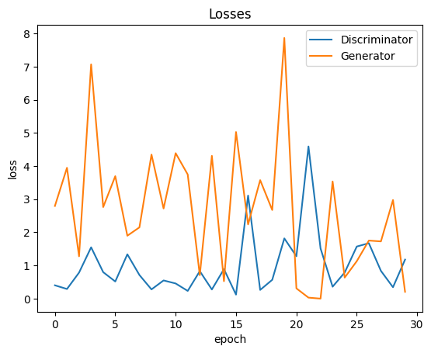
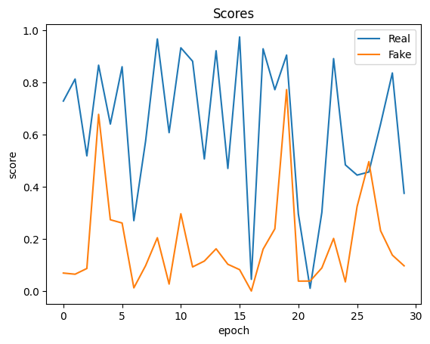
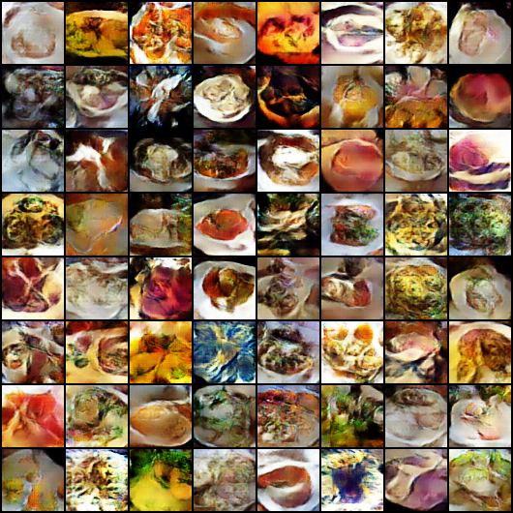
RESULTS
FAKE IMAGE GENERATED
Ideally, as the number of epochs increases, the generator will get better at creating realistic data, and the discriminator will get worse at telling the difference between real and fake data. This can be seen in the graph as a downward trend in both the generator and discriminator loss lines.
13

